Slide 1
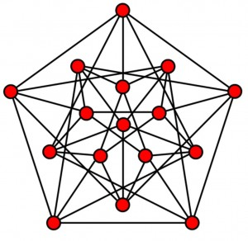
The Incredibles
Graph Theory
August 3, 2022
Muhammad Mustafa

Slide 2
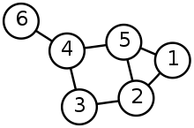
Graph theory
In mathematics, graph theory is the study of graphs, which are mathematical structures used to model pairwise relations between objects.
A graph is made up of nodes and edges that connect those vertices.

Slide 3
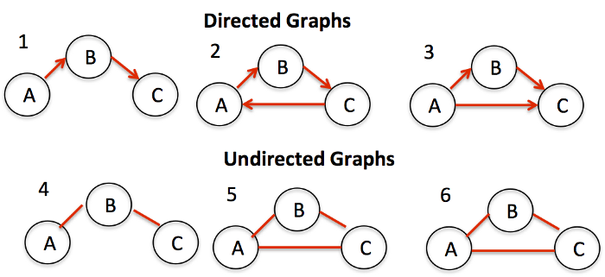
Directed vs. Undirected
A graph may be undirected (meaning that there is no distinction between the two vertices associated with each bidirectional edge) or a graph may be directed (meaning that its edges are directed from one vertex to another but not necessarily in the other direction).

Slide 4
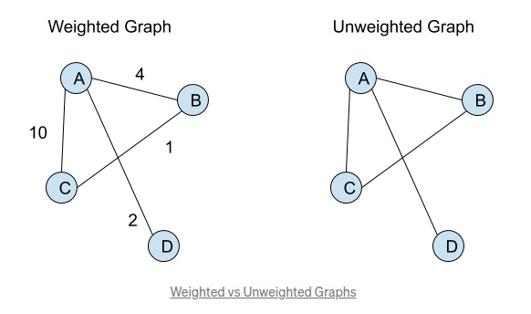
Weighted vs. Unweighted
A graph may be weighted (by assigning a weight to each edge, which represent numerical values associated with that connection) or a graph may be unweighted (either all edges have unit weight 1 or all edges have the same constant weight).
Note that weight can be negative.

Slide 5
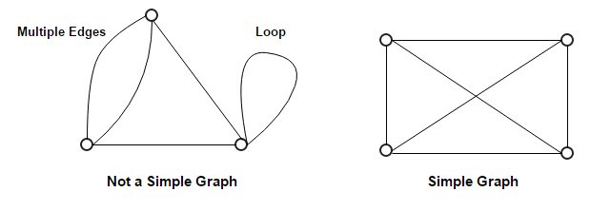
Simple Graph
In a simple graph, there is no self-loop edge (an edge that connects a vertex with itself) and no parallel multiple edges (there can only be up to one edge between a pair of distinct vertices).
Graph algorithms on simple graphs are easier than on non-simple graphs.

Slide 6
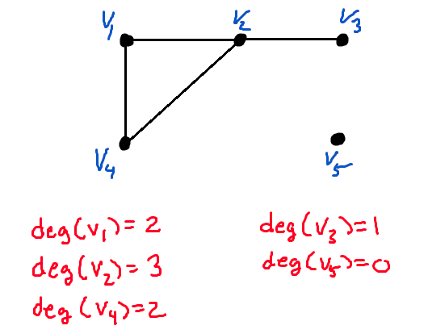
Degree of a Vertex [undirected]
In an undirected graph, the degree of a vertex v is the number of edges incident with v. A vertex of degree 0 is called an isolated vertex.

Slide 7
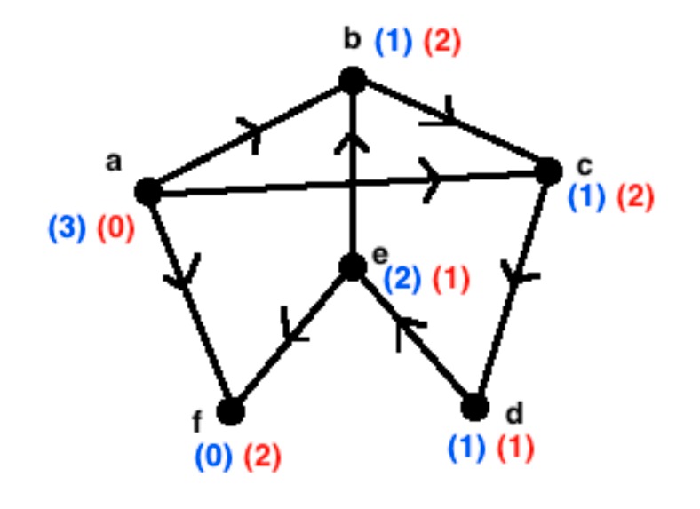
In-degree/Out-degree [Directed]
In a directed graph, we have to further differentiate the degree of a vertex v into in-degree and out-degree. The in-degree/out-degree is the number of edges coming-into/going-out-from v, respectively.

Slide 8
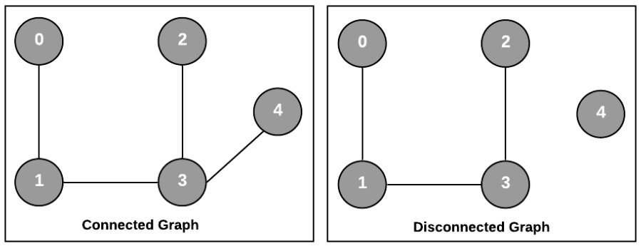
Connected Graph
Graph G is called connected if there is a path between every pair of distinct vertices of G.

Slide 9
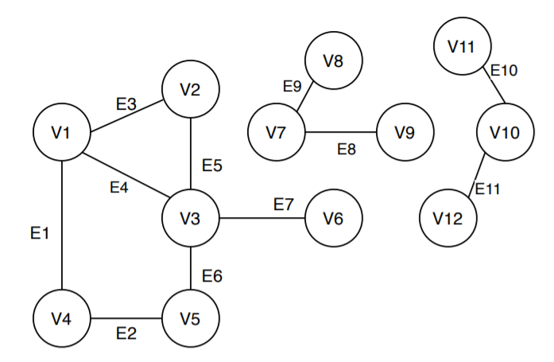
Connected Components
A connected component of an undirected graph is a subgraph in which each pair of nodes is connected with each other via a path.
The graph my contains more than one connected components.

Slide 10
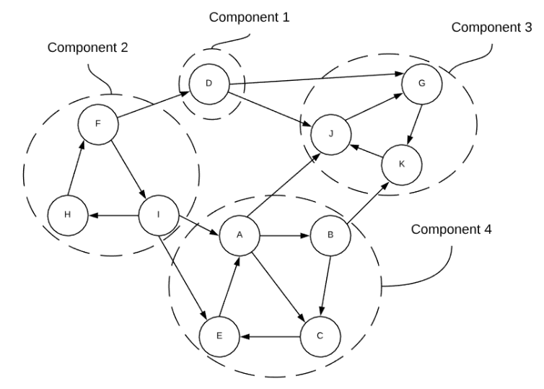
Strongly Connected Component
In a directed graph, we define the concept of Strongly Connected Component (SCC).

Slide 11
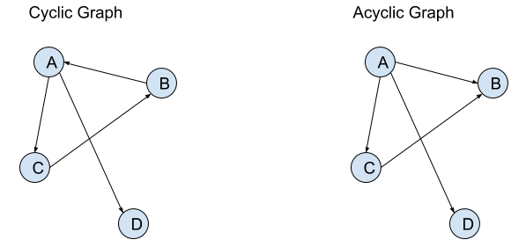
Cyclic vs. Acyclic Graph
An acyclic graph does not have any cycles. There is a cycle in a graph if you can visit a vertex and come back to the same vertex while traversing. But there isn’t any cycle in the acyclic graph.
In an undirected graph, each of its undirected edge causes a trivial cycle although we usually will not classify it as a cycle.

Slide 12
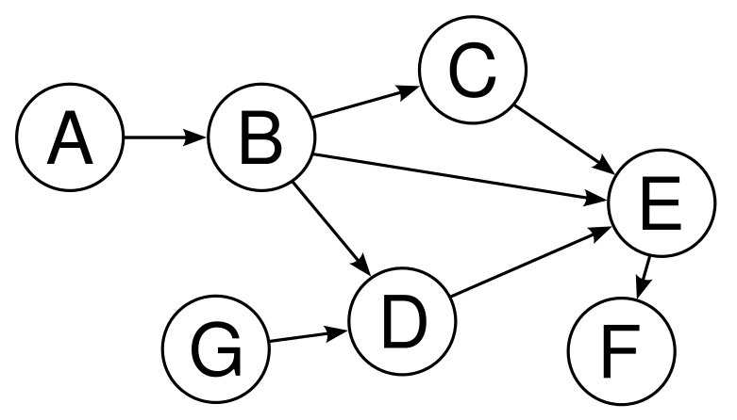
Directed Acyclic Graph (DAG)
Directed Acyclic Graph (DAG) is a directed graph that has no cycle, which is very relevant for Dynamic Programming (DP) techniques.
Each DAG has at least one Topological Sort/Order which can be found with a simple tweak to any Graph Traversal algorithm.

Slide 13
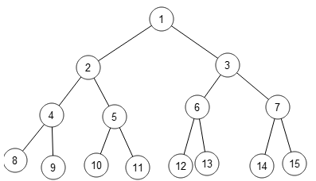
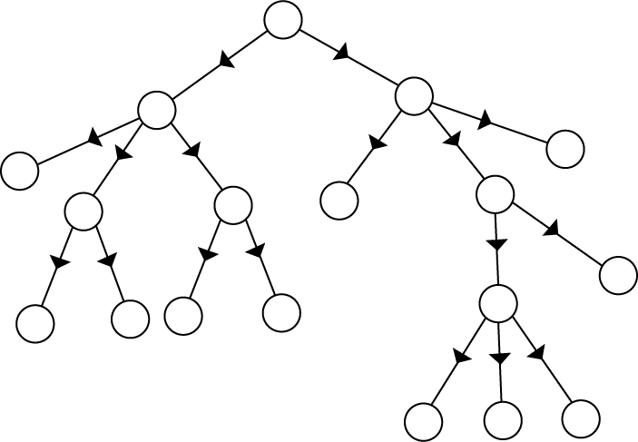
Tree
Tree is a connected graph with V vertices and E = V-1 edges, acyclic, and has one unique path between any pair of vertices. Usually a Tree is defined on undirected graph. An undirected Tree actually contains trivial cycles but it does not contain non-trivial cycle. A directed Tree is clearly acyclic.
A lot of tasks are way easier on tree than a normal graph.

Slide 14
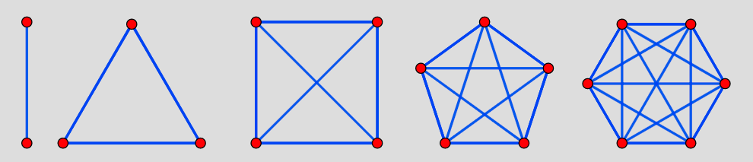
Complete graph
Complete graph is a graph with V vertices and E = V*(V-1)/2 edges, i.e., there is an edge between any pair of vertices. Complete graph is the most dense simple graph.

Slide 15
Representation In Memory
There are many ways to store graph information into a graph data structure, each with its own strengths and weaknesses.
Adjacency Matrix (AM) is a square matrix where the entry AM[i][j] shows the edge's weight from vertex i to vertex j. For unweighted graphs, we can set a unit weight = 1 for all edge weights. We simply use Java native 2D array/list of size VxV to implement this data structure.
Space Complexity Analysis: An AM unfortunately requires a big space complexity of O(V^2), even when the graph is actually sparse (not many edges).
Adjacency List (AL) is an array of V lists, one for each vertex where for each vertex i, AL[i] stores the list of i's neighbors. For weighted graphs, we can store pairs of (neighbor vertex number, weight of this edge) instead.
Space Complexity Analysis: AL has space complexity of O(V+E), which is much more efficient than AM and usually the default graph DS inside most graph algorithms.
Edge List (EL) is a list of pairs, each pair (u, v) represents and edge between u and v.
After storing our graph information into a graph DS, we can answer a few simple queries.
Counting V: In an AM and AL, V is just the number of rows in the data structure that can be obtained in O(V) or even in O(1) — depending on the actual implementation.
Counting E: Enumerating neighbors of a vertex u,
- In an AM, we need to loop through all columns of AM[u][j] ∀j ∈ [0..V-1] and report pair of (j, AM[u][j]) if AM[u][j] is not zero. This is O(V) — slow.
- In an AL, we just need to scan AL[u]. If there are only k neighbors of vertex u, then we just need O(k) to enumerate them — this is called an output-sensitive time complexity and is already the best possible.
Checking the existence of edge (u, v):
- In an AM, we can simply check if AM[u][v] is non zero. This is O(1) — the fastest possible.
- In an AL, we have to check whether AL[u] contains vertex v or not. This is O(k) — slower.

Slide 16
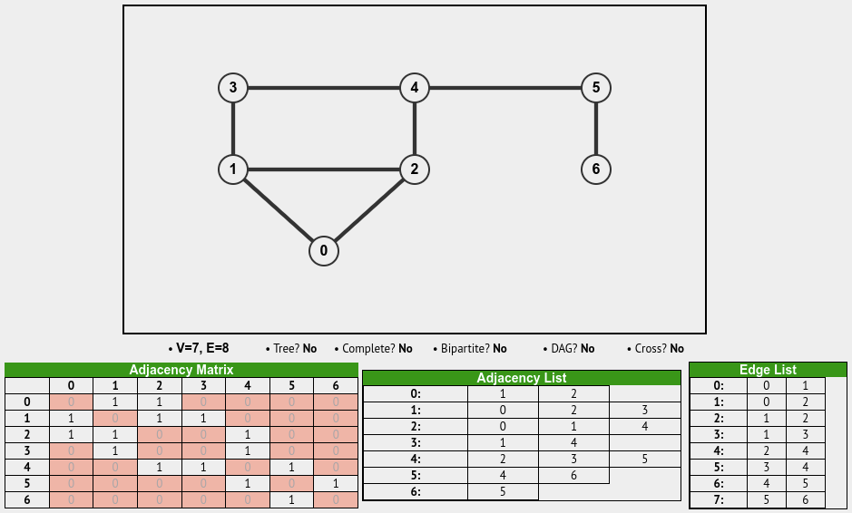
Representation In Memory UNDIRECTED/UNWEIGHTED

Slide 17
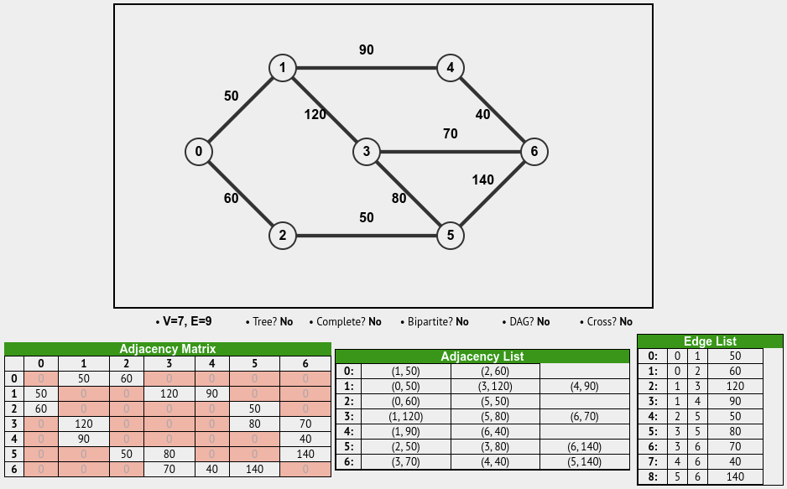
Representation In Memory UNDIRECTED/WEIGHTED

Slide 18
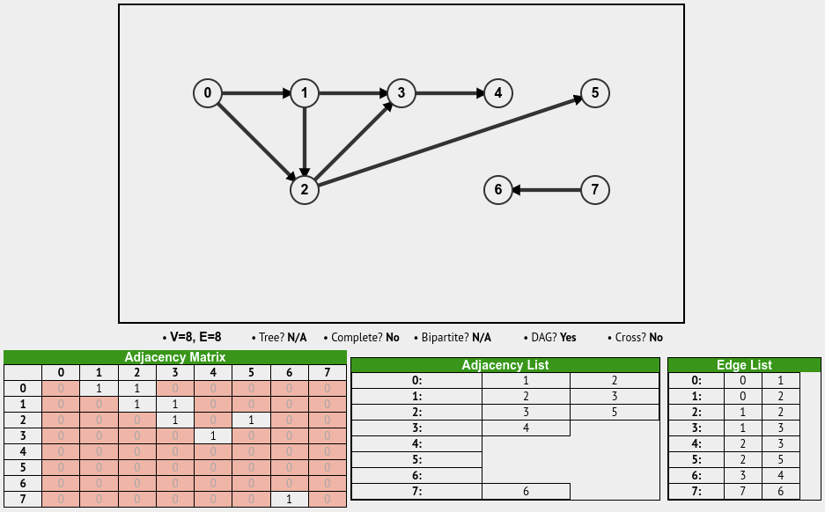
Representation In Memory DIRECTED/UNWEIGHTED

Slide 19
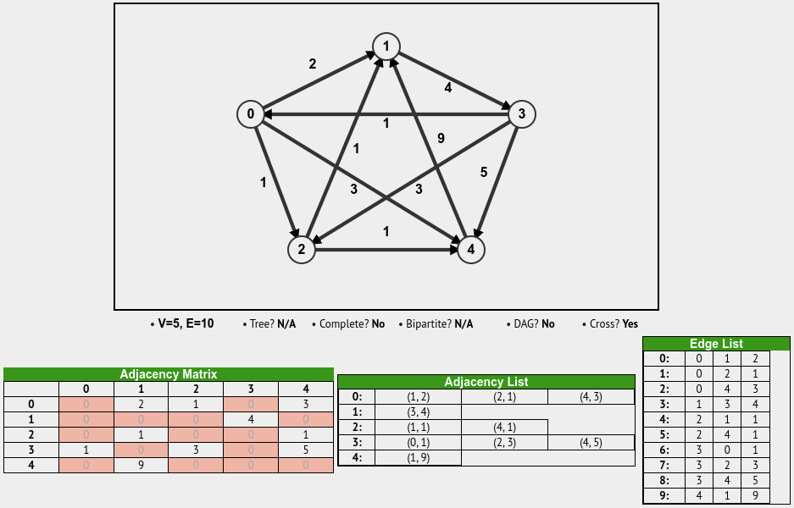
Representation In Memory DIRECTED/WEIGHTED

Slide 20
Graph Traversing/Searching
The two most common ways to search a graph are depth-first search and breadth-first search.
In depth-first search (DFS), we start at the root (or another arbitrarily selected node) and explore each branch completely before moving on to the next branch. That is, we go deep first (hence the name depth first search) before we go wide.
In breadth-first search (BFS), we start at the root (or another arbitrarily selected node) and explore each neighbor before going on to any of their children. That is, we go wide (hence breadth-first search) before we go deep.

Slide 21
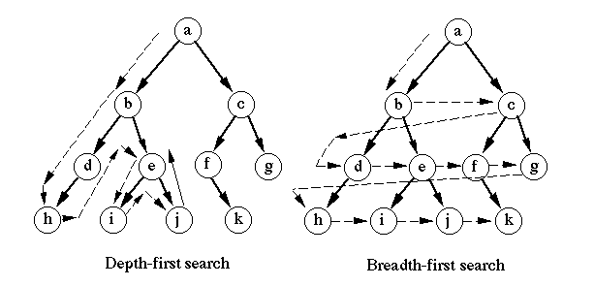
Graph Traversing/Searching

Slide 22
Problems
https://leetcode.com/problems/maximum-depth-of-n-ary-tree/
https://leetcode.com/problems/find-if-path-exists-in-graph/
https://leetcode.com/problems/number-of-provinces/
https://leetcode.com/problems/flood-fill/
https://leetcode.com/problems/max-area-of-island/

Slide 23
Resources
https://visualgo.net/en
https://www.amazon.com/Discrete-Mathematics-Its-Applications-Seventh/dp/0073383090
https://cpbook.net/
https://www.amazon.com/Cracking-Coding-Interview-Programming-Questions/dp/0984782850
Google Images

Slide 24
Merci
Thank you

